Slide 1
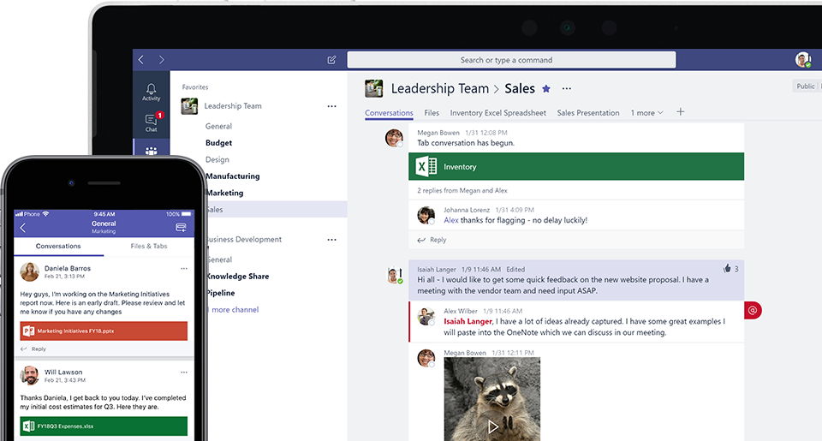
Microsoft Teams: The Future of Collaboration, Today

Slide 2
Housekeeping
Presentation is being recorded and will be sent out next week
Keep the questions coming! Type them in and we will do our best to get to them.
Notes:
Also will sent Starbucks gift card for Canadian attendees and Dunkin donuts for Americans

Slide 3
Meet your Presenter
Elizabeth Brown
Business Solutions Consultant
Corporate Renaissance Group (CRGroup)

Slide 4
Agenda
Modern collaboration – why it’s crucial
Getting to know the possibilities in Teams!
Forums
Document Collaboration
Online meetings and screen sharing
Chatting and group discussions
Employee recognition
Planner tasks
Integrations!

Slide 5
Why is Collaboration SO Crucial?
Fast-paced environments demanding immediate access to information and sharing/communicating between company groups and teams.
Access is key. Employees aren’t all in one space and need information and tools available from anywhere, across all devices.
Companies that streamline communication, experience improved productivity, better customer services, and the ability to offer flexibility that helps to attract/retain better talent.
Notes:
So why is collaboration so crucial?
The way companies work is changing. It’s faster-paced combined with higher pressure. There’s a sense that everything is needed immediately. The ability for more people across teams to collaborate on projects at the same time, the faster the results.
Also, in a modern work environment, remote working is key. These days, employees need to be able to share information instantly wherever they are. With Microsoft Teams, your staff can work together on a secure system while having the freedom they desire.
We can see how important collaboration is for today’s workforce as more and more people are adopting Microsoft Teams. Microsoft Teams is a hub for teamwork, a chat-based workspace that enables teams to be more productive by giving them a single and secure location, bringing together everything a team needs: chats, meetings, calls, files, and tools.

Slide 6
But is Collaboration Enough?
Collaboration is challenging unless everything is integrated & completely accessible.
Most companies use 3+ systems for collaboration across chat, meetings, sharing, file management etc.
Teams offers ONE hub for company collaboration and a must for any organization using Office 365.

Slide 7
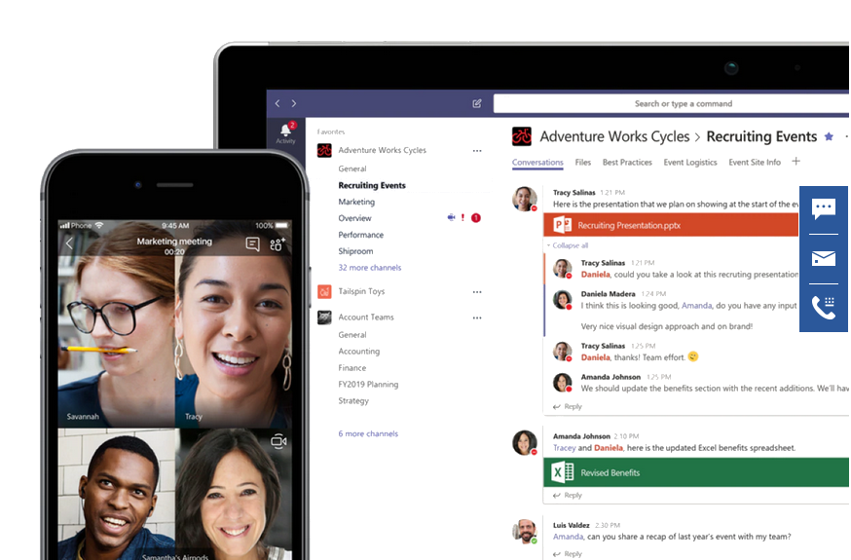
What is Microsoft Teams?
It is the Microsoft collaboration tool
It is the replacement for Skype for Business
Built on Office 365 groups and SharePoint Team Sites
Integrates with Planner and other apps (both Microsoft and non-Microsoft)

Slide 8
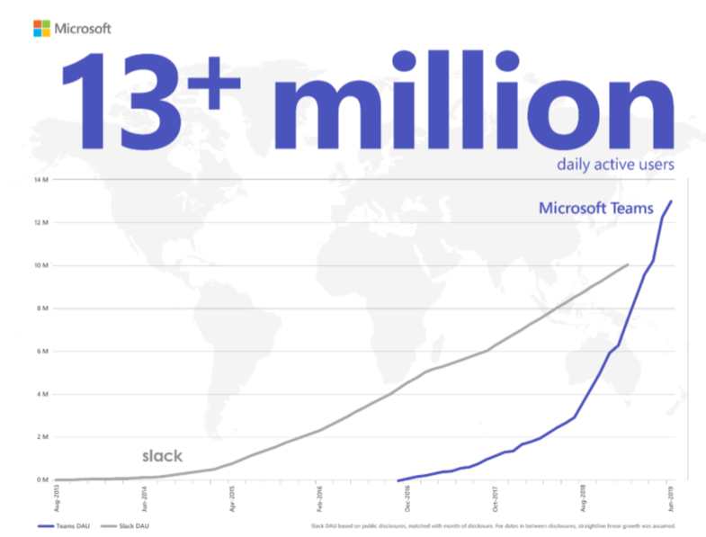
Fastest Growing Office 365 Product
Spiceworks conducted surveys of 901 organizations in 2016 and 2018:
21% of organizations used Teams in 2018
3% of organizations used Teams in 2016
Teams was the second most popular collaboration tool in 2018 (First place was Skype for Business)
As of July 2019, 13+ million daily active users in Teams!
According to Microsoft, 87 or the Fortune 100 are now using Teams in some way.

Slide 9
What does Teams Offer?
Chat
Meetings
Whiteboards
Fill in here……

Slide 10
Let’s take a look!

Slide 11
Recap
Microsoft Teams is the collaboration tool
It is built on and integrates with many different Microsoft products
Microsoft Teams is experiencing incredible growth so expect new functions to be added

Slide 12
Questions?
Get started today! crgroup.com/teams
Contact us to learn more crg@crgroup.com
SETUP • TRAINING • INTEGRATION
Notes:
At this time I will turn my attention to any questions entered into the webinar panel

Slide 13
Thank You!
Thank you!
Contact us to learn more
crg@crgroup.com | 613.232.4295
crgroup.com/teams
Elizabeth Brown
613.232.4295 x:310
ebrown@crgroup.com
Your Partner for Microsoft Solutions & Core Business Systems!
DYNAMICS 365 • OFFICE 365 • TEAMS • BUDGETING • TALENT

